Slide 1
Ulinkers
Midterm Presentation
Teh Kaixin
Nicole Goh
Sean Kwok
Nabilah Banu
Chien Shu Yan

Slide 2
Agenda
Introduction
Problem & Solution
Technologies
User Testing
Project Management
X-Factor
Reflections

Slide 3








Nicole Goh
Teh Kaixin
Lead Frontend Developer
Deputy Project Manager
Project Manager
Deputy Quality Assurance
Nabilah Banu
Business Analyst
Deputy Frontend Developer
Sean Kwok
Chien Shu Yan
Lead Backend Developer
Lead Quality Assurance
Professor Steven Hoi
Linda Siow
Supervisor
Sponsor
Introduction
Problem and Solution
Technologies
User Testing
Project Management
X-Factor
Reflections

Slide 4



Operating since 1996
Our Sponsor
Medical concierge provider:
Clinic & hospitalisation arrangements
Treatment plans & price estimates
Travel arrangements & visas
Standby assistance in Singapore
Ulink Assist Pte Ltd
Clients:
Indonesia, Malaysia, Cambodia, Vietnam, Myanmar & China
15 Employees

Slide 5
Problem
Unable to keep track of teams’ performances
No platform for Ulink to recommend screenings to client
No consolidated client profile
Difficult to determine engagements with stakeholders
Unable to generate relevant reports from current system
Introduction
Problem and Solution
Technologies
User Testing
Project Management
X-Factor
Reflections
Notes:
currently customers come to find ulink for screenings and there is no platform for ulink to push screenings to customers.
Duplicate records – cannot follow up easily

Slide 6
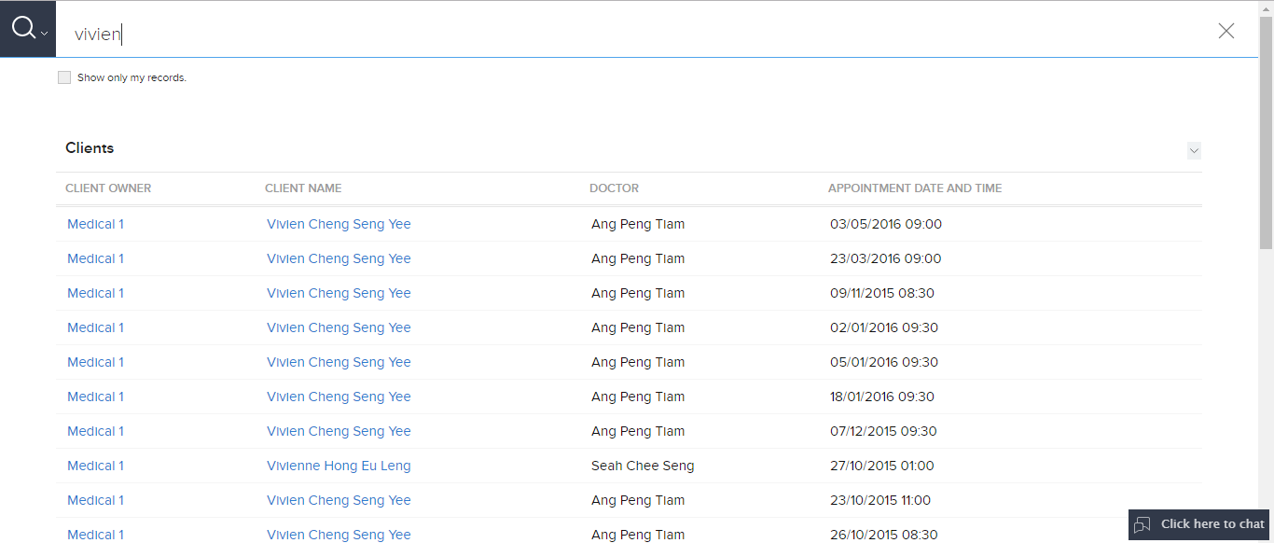
Problem
Introduction
Problem and Solution
Technologies
User Testing
Project Management
X-Factor
Reflections
Notes:
currently customers come to find ulink for screenings and there is no platform for ulink to push screenings to customers.
Duplicate records – cannot follow up easily

Slide 7
Ulink Reporting System
Reporting tools for decision making
(Specific KPI of different teams, Gender - Age, Ranking of stakeholders, POC Index)
1
2
Screenings recommendation
3
Dashboard displays statistics
Client profile page
(reduce duplicates, group by client name)
4
Introduction
Problem and Solution
Technologies
User Testing
Project Management
X-Factor
Reflections

Slide 8
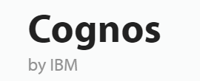


Research
Pros: | Intuitive Reports Flexible deployment | Wide range of data visualization
Cons: | Most functions not required Difficult to manage More appropriate for huge organisation Sharing of insights can be complicated | Can be cost prohibitive Still need IT expertise for data preparation No functionality for scheduling or notification of reports
Introduction
Problem and Solution
Technologies
User Testing
Project Management
X-Factor
Reflections

Slide 9



Comparison
Recommended screening based on demographic
Dashboard Reporting (Key performance metrics)
Monitor Departments’ Performance
Ranking (Stakeholder engagements)
Client Profile (Consolidated profile view of each client)
Email function
Generate Reports
Introduction
Problem and Solution
Technologies
User Testing
Project Management
X-Factor
Reflections

Slide 10
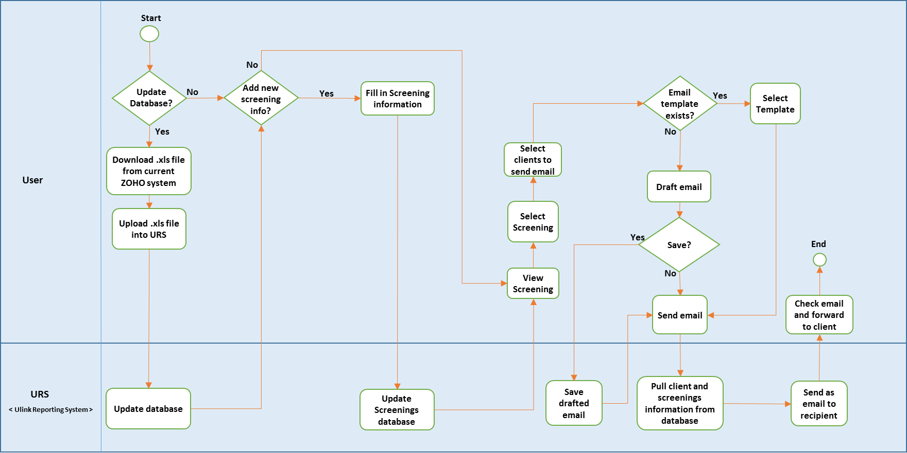
To-Be Workflow (Screenings and Email)
Introduction
Problem and Solution
Technologies
User Testing
Project Management
X-Factor
Reflections

Slide 11
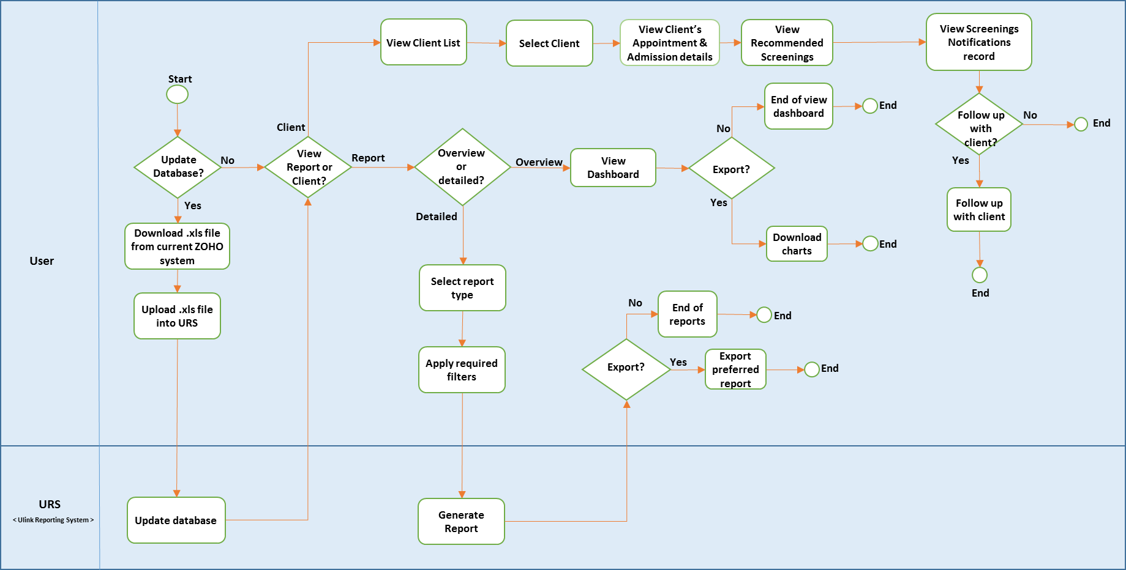
To-Be Workflow (Client, Dashboard and Reports)
Introduction
Problem and Solution
Technologies
User Testing
Project Management
X-Factor
Reflections

Slide 12

DEMONSTRATION
Introduction
Problem and Solution
Technologies
User Testing
Project Management
X-Factor
Reflections

Slide 13

Technology
Architecture Diagram
Technical Complexity

Slide 14












Architecture Diagram
FRONTEND
BACKEND
OTHER SERVICES
HTTP GET POST JSON
JSON OUTPUT
Introduction
Problem and Solution
Technologies
User Testing
Project Management
X-Factor
Reflections

Slide 15
TECHNICAL COMPLEXITY
Introduction
Problem and Solution
Technologies
User Testing
Project Management
X-Factor
Reflections

Slide 16
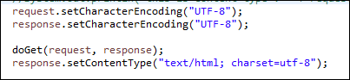
Technical Complexity
Encoding Character
Problems:
Default Encoding value for getParameter - ISO-8859-1
Unable to read UTF-8 encoding value
Solution:
Change database storing format and encoding value for getParameter
Introduction
Problem and Solution
Technologies
User Testing
Project Management
X-Factor
Reflections

Slide 17
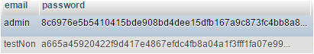
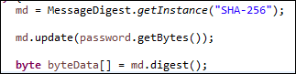
Technical Complexity
Security
Problems:
To prevent client information being compromised
Solution:
Encrypt password using SHA-256
Introduction
Problem and Solution
Technologies
User Testing
Project Management
X-Factor
Reflections

Slide 18
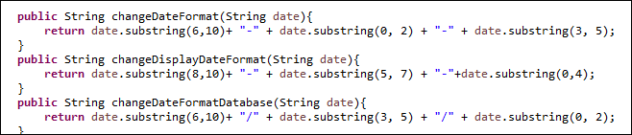
Technical Complexity
Different Date Formats
Problems:
Many different types of date format required
Solution:
Joda Time library & calendar from Java
Introduction
Problem and Solution
Technologies
User Testing
Project Management
X-Factor
Reflections

Slide 19
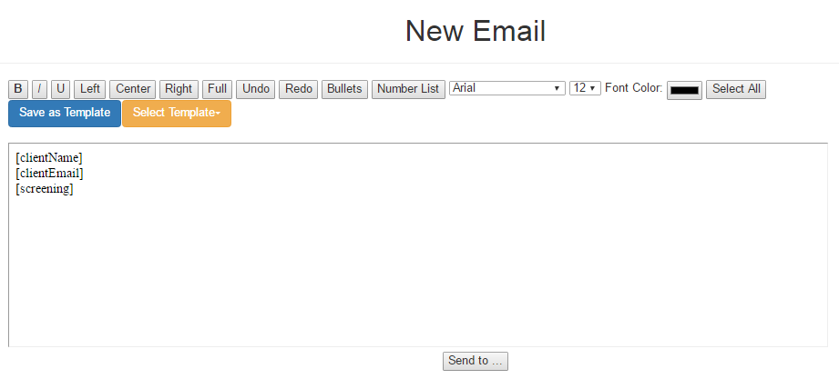
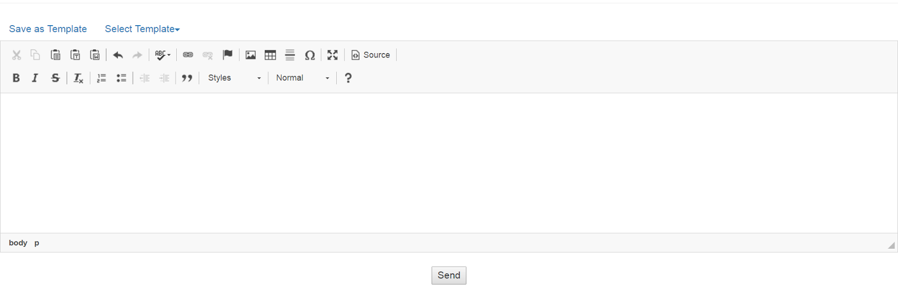
Technical Complexity
Text Editor (iFrame)
Problems:
Edit mode not user-friendly
Cannot save pasted text directly
Looks “Raw”
Solution:
Before
After
Introduction
Problem and Solution
Technologies
Project Management
User Testing
X-Factor
Reflections

Slide 20
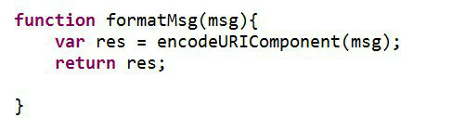
Technical Complexity
Saving Email template in HTML format
Problem:
Need to replace symbols to preserve original format
Solution:
EncodeURIComponent
Introduction
Problem and Solution
Technologies
User Testing
Project Management
X-Factor
Reflections

Slide 21

Quality Assurance
User Testing
Internal Testing

Slide 22


User Testing 1
Purpose: Gather UI feedback & detect usability issues
Participant: Linda (Sponsor)
Date: 28 October 2016
Time: 4.00pm
Venue: Ulink Assist Pte Ltd
Scope:
Client Creation Module
Timeline Module
Reports Module
KPI
Ranking
Gender - Age Report
Easy to navigate
Timeline for screenings design is not intuitive
Naming of columns and fields are confusing
Introduction
Problem and Solution
Technologies
User Testing
Project Management
X-Factor
Reflections
Notes:
Client prefers to choose which patient to send email to instead of automated sending of email
Analysis results to be in numbers

Slide 23
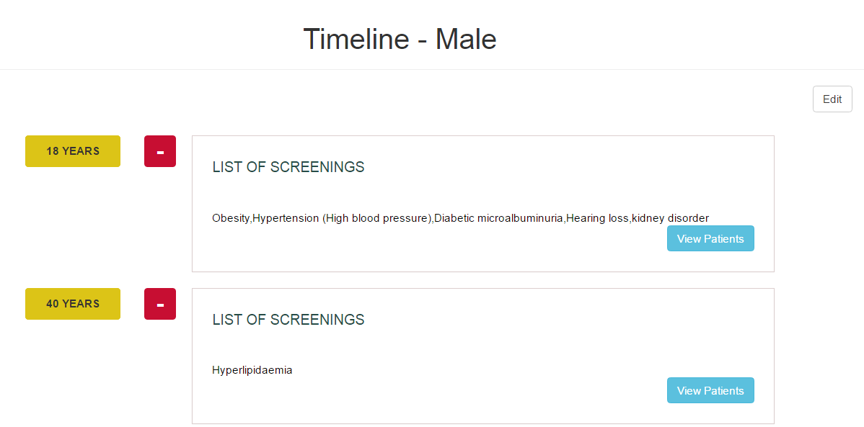
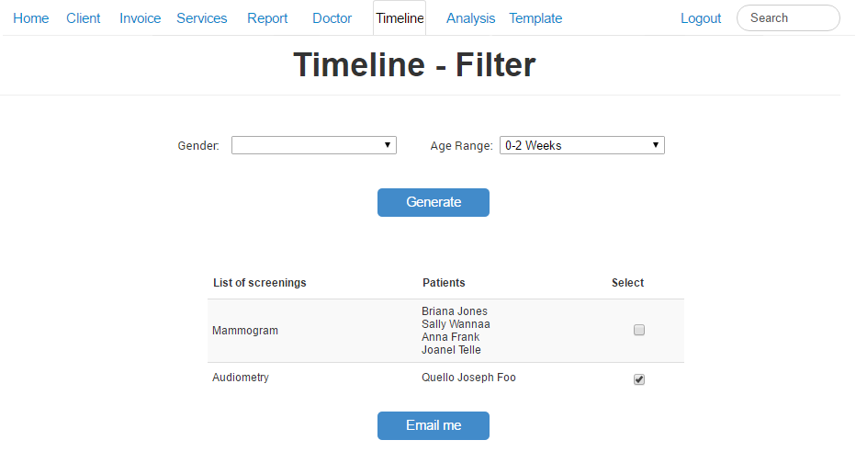

UT 1 Feedback
Timeline display is not intuitive, user suggested to change to table format
Stick to one color scheme
Client prefers to choose which patient to send email to instead of automated sending of email
Before
After
Introduction
Problem and Solution
Technologies
User Testing
Project Management
X-Factor
Reflections

Slide 24
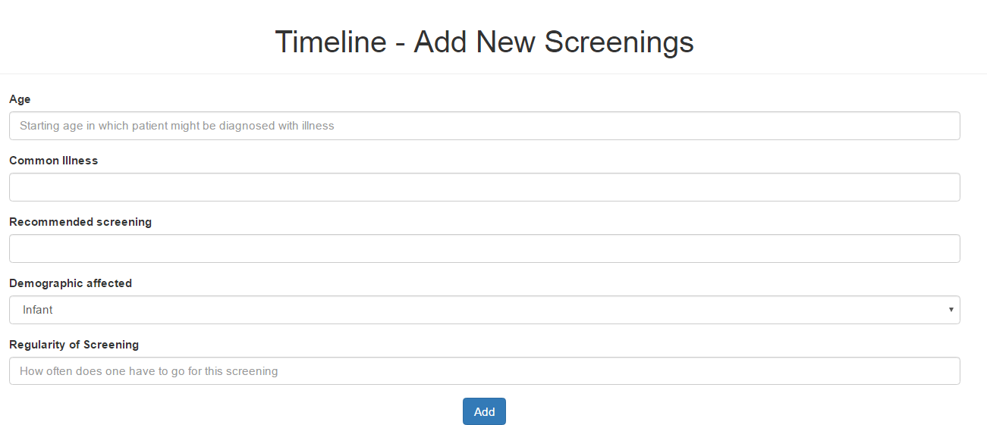
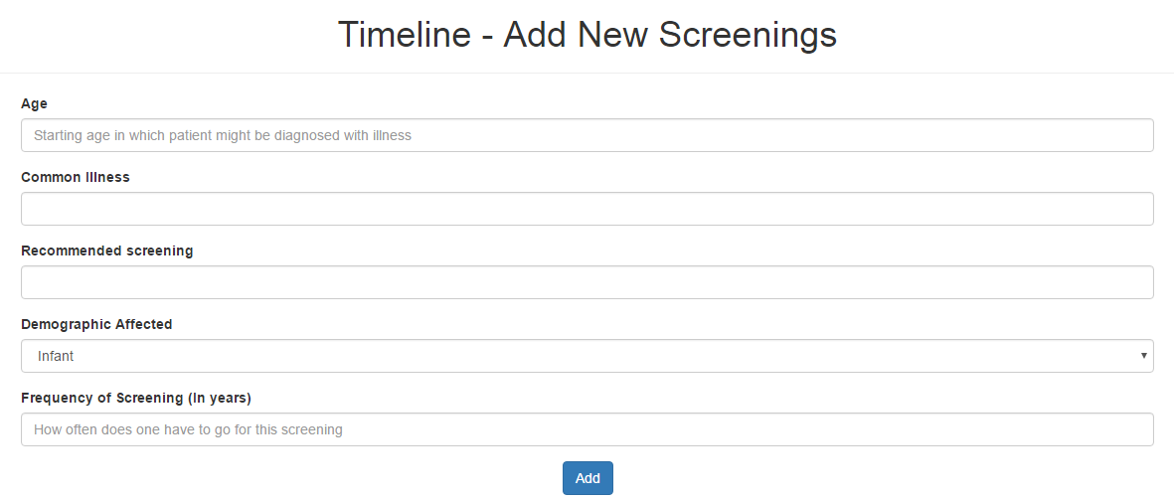
UT 1 Feedback
Rename Regularity field to Frequency of Screening (In Years) for easy understanding
Before
After
Introduction
Problem and Solution
Technologies
User Testing
Project Management
X-Factor
Reflections

Slide 25
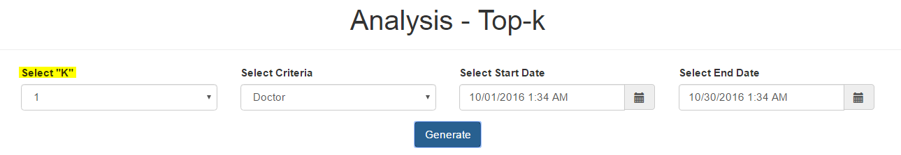

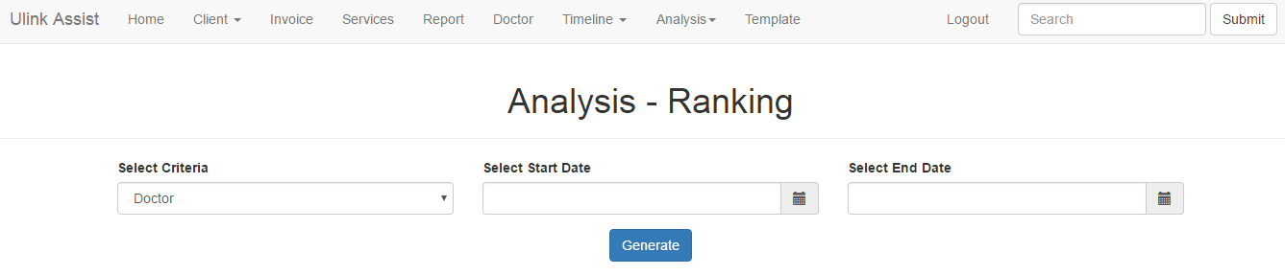
UT 1 Feedback
Top-K function to rename as "Ranking" for easy understanding
List all results in a ranked list instead of selecting “K” value
Before
After
Introduction
Problem and Solution
Technologies
User Testing
Project Management
X-Factor
Reflections

Slide 26
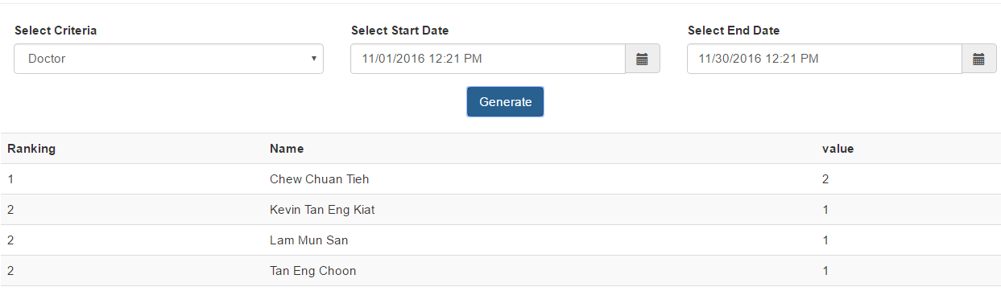
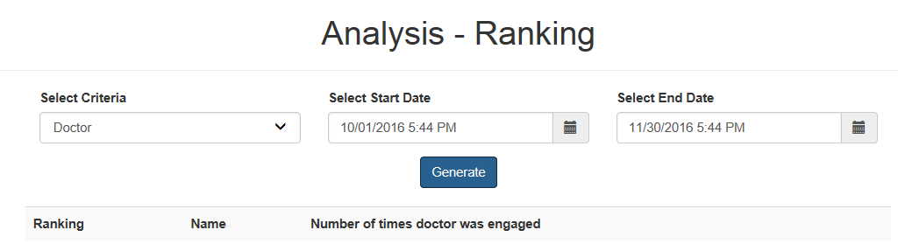
UT 1 Feedback
Confusing naming
Before
After
Introduction
Problem and Solution
Technologies
User Testing
Project Management
X-Factor
Reflections

Slide 27
User Testing 2
Usability & Heuristic Test
Purpose: Identify any usability problems & UI issues
Participant: 5 Ulink employees
(Management, Medical, Visa, Marketing, Accounts)
Date: 10 January 2017
Time: 3.30pm
Venue: Ulink Assist Pte Ltd
Scope:
Login/ Logout
Screenings
Client
Data Management
Introduction
Problem and Solution
Technologies
User Testing
Project Management
X-Factor
Reflections
Notes:
Client prefers to choose which patient to send email to instead of automated sending of email
Analysis results to be in numbers

Slide 28
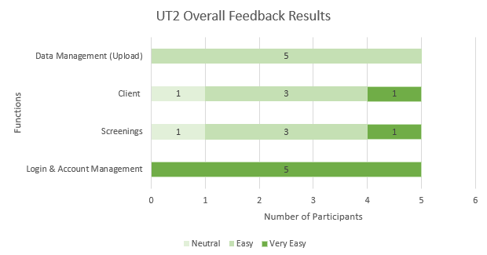
UT 2 Usability
Introduction
Problem and Solution
Technologies
User Testing
Project Management
X-Factor
Reflections
Notes:
Client prefers to choose which patient to send email to instead of automated sending of email
Analysis results to be in numbers

Slide 29
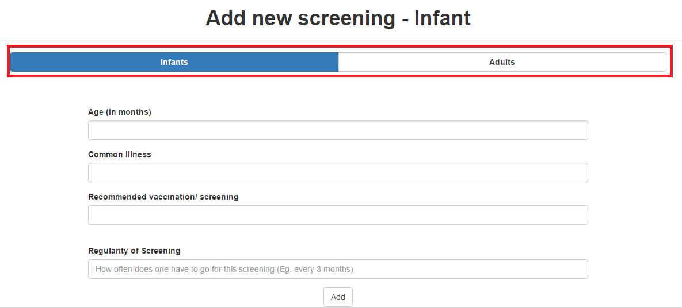
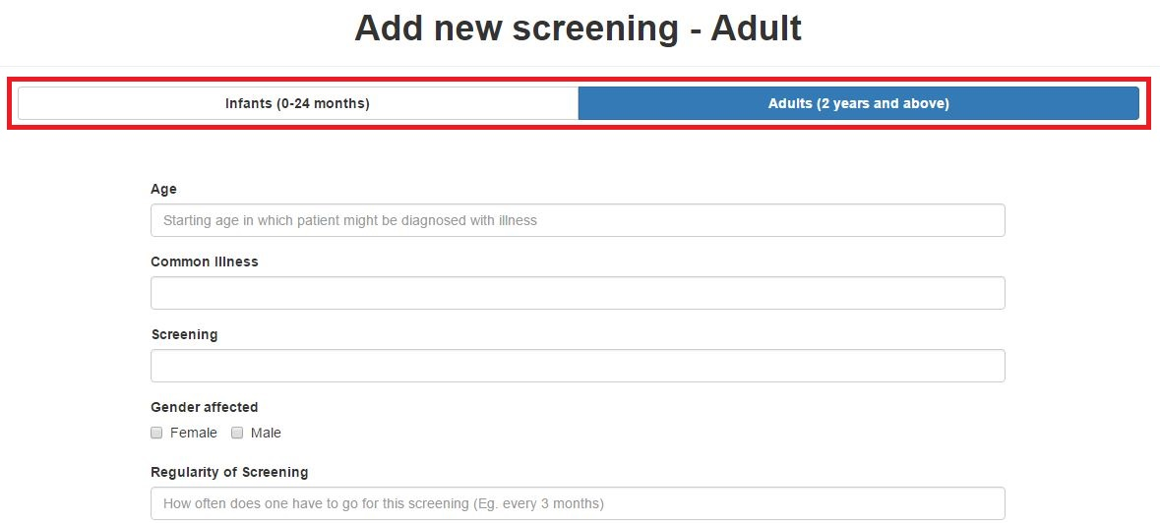
UT 2 Heuristics Improvements
Header of Screening form is not specific
Before
After
Introduction
Problem and Solution
Technologies
User Testing
Project Management
X-Factor
Reflections

Slide 30
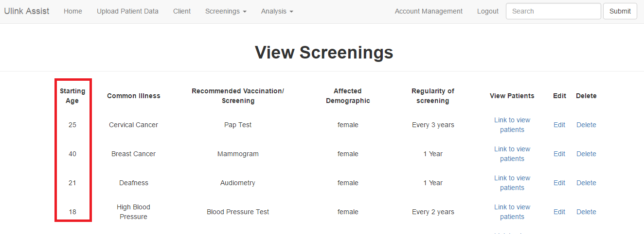
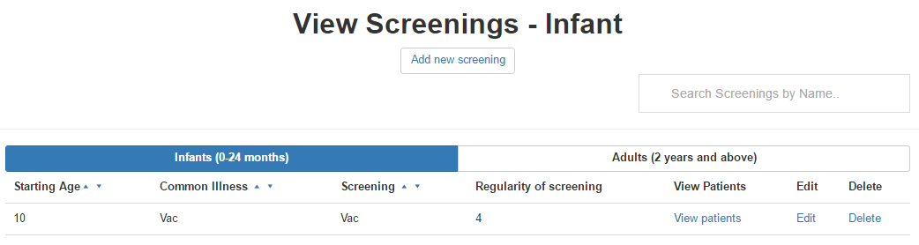
UT 2 Heuristics Improvements
Infants and Adults screenings should have different views
To prevent confusion in age (months, years)
Before
After
Introduction
Problem and Solution
Technologies
User Testing
Project Management
X-Factor
Reflections

Slide 31
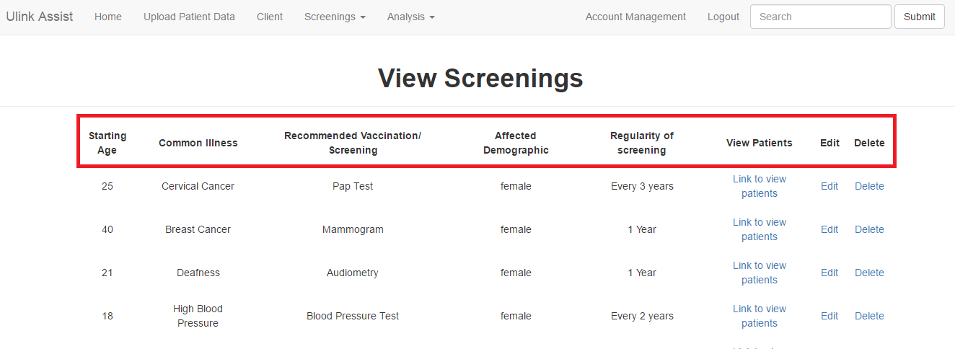
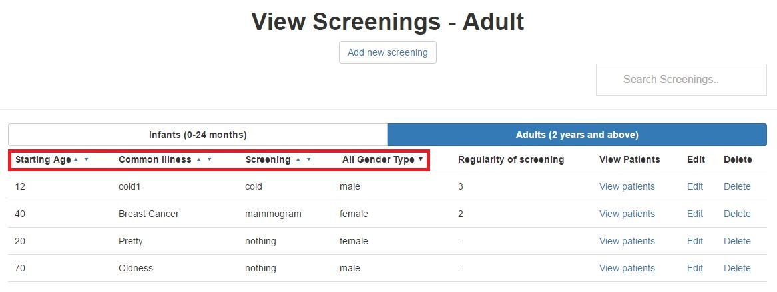
UT 2 Heuristics Improvements
Difficult to search for particular client/ screenings
Search & sort features allow easier search
Before
After
Introduction
Problem and Solution
Technologies
User Testing
Project Management
X-Factor
Reflections

Slide 32


User Testing 3
Purpose:
Gather UI feedback & detect usability issues
Measure time taken for each task
Participant: 6 Ulink employees
(Management, Medical, Visa, Marketing, Accounts)
Date: 13 February 2017
Time: 4.30pm
Venue: Ulink Assist Pte Ltd
Scope:
Data Management
Dashboard Module
Reports Module
KPI, Ranking, Gender-Age
Screenings
Email Notification
Text Editor
Dashboard & Reports
Visual graphs provides better understanding
User interface
Straightforward & user-friendly
Introduction
Problem and Solution
Technologies
User Testing
Project Management
X-Factor
Reflections

Slide 33
User Testing 3 Procedure
Login
Data Management
Reports -KPI
Reports - Ranking
Gender and Age
Screening
Dashboard
Email Recommended Screenings
Introduction
Problem and Solution
Technologies
User Testing
Project Management
X-Factor
Reflections

Slide 34
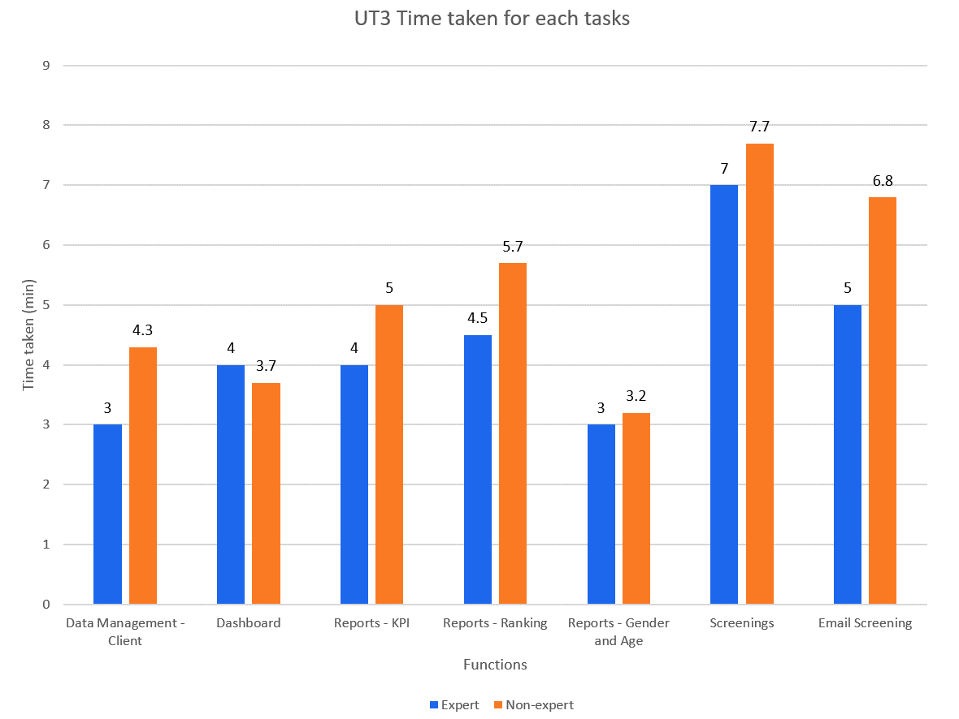
User Testing 3 Results
Non–experts should take not more than 150% of expert’s time taken
Introduction
Problem and Solution
Technologies
User Testing
Project Management
X-Factor
Reflections

Slide 35
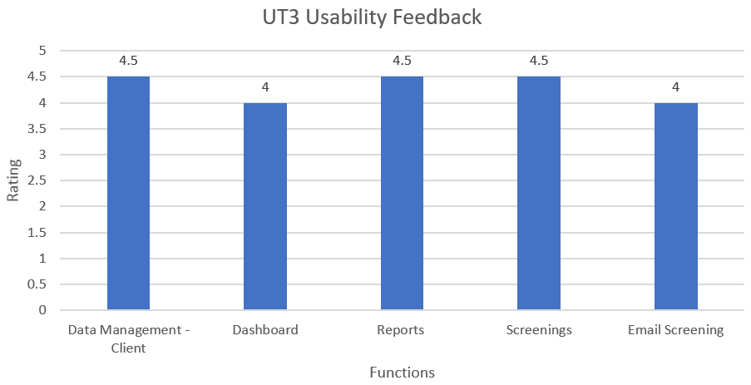
UT 3 Feedback
Very Easy
Very Difficult
Introduction
Problem and Solution
Technologies
User Testing
Project Management
X-Factor
Reflections

Slide 36
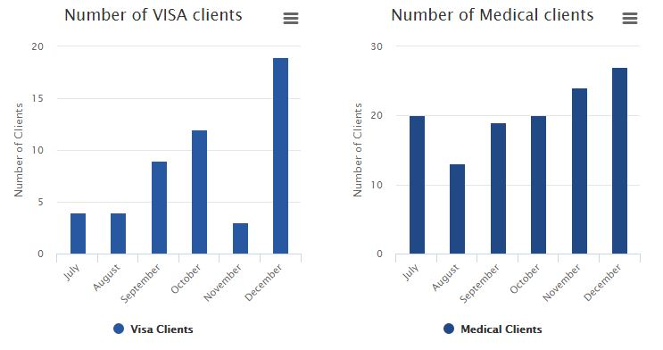
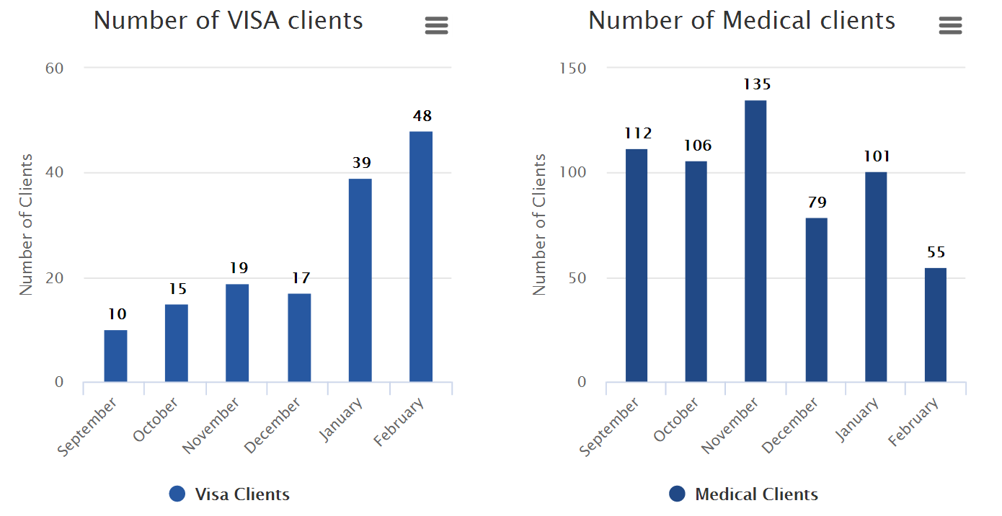
UT 3 Feedback
Data labels added
Before
After
Introduction
Problem and Solution
Technologies
User Testing
Project Management
X-Factor
Reflections

Slide 37
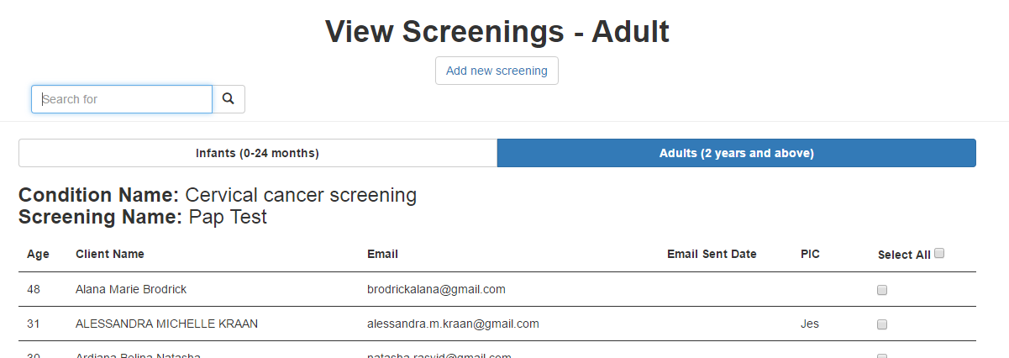
UT 3 Feedback
Select All Button
‘PIC’ column
‘Email Sent’ column (Last sent date)
Introduction
Problem and Solution
Technologies
User Testing
Project Management
X-Factor
Reflections

Slide 38
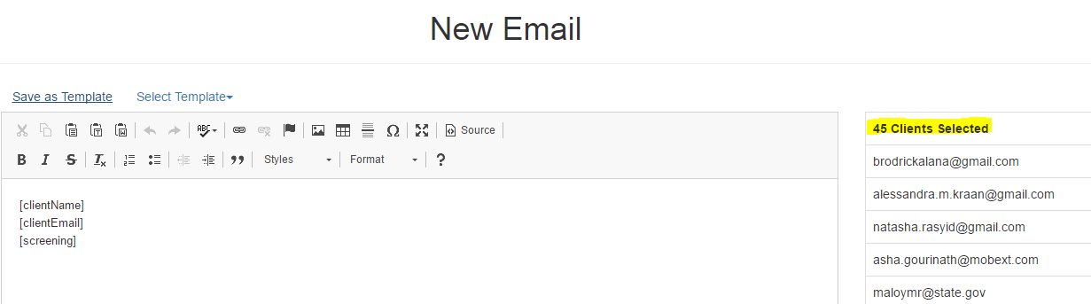
UT 3 Feedback
Number of clients selected
Before
Introduction
Problem and Solution
Technologies
User Testing
Project Management
X-Factor
Reflections

Slide 39
UT 3 Feedback
Improvements to be made
Uploading images
Specify recipients
Introduction
Problem and Solution
Technologies
User Testing
Project Management
X-Factor
Reflections

Slide 40

UT Takeaways
Many suggestions from different users
Importance of prioritising changes
Introduction
Problem and Solution
Technologies
User Testing
Project Management
X-Factor
Reflections

Slide 41
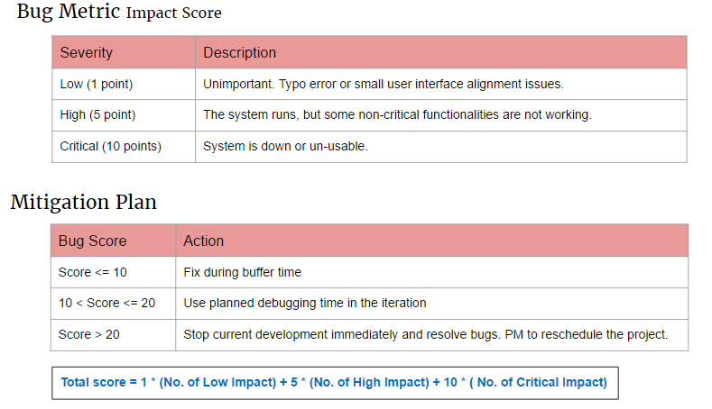
Bug Metric
Introduction
Problem and Solution
Technologies
User Testing
Project Management
X-Factor
Reflections

Slide 42
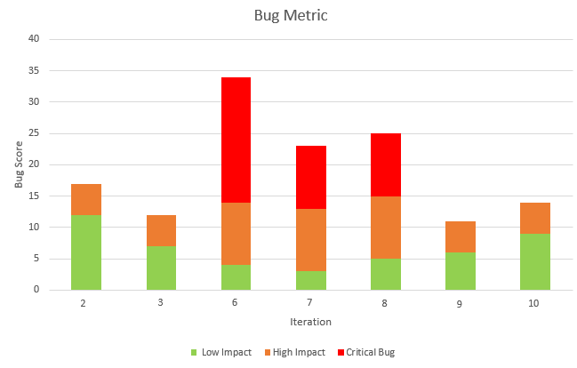
Bug Metric
2
1
1
1
2
1
1
2
1
12
2
7
6
9
4
3
5
Introduction
Problem and Solution
Technologies
User Testing
Project Management
X-Factor
Reflections
Notes:
Iteratiom 6 : screenings: cannot update and cannot cclick on view patients list
Iteration 7: data management : client profile does not display as expected. Information displayed is wrong.
Iteration 8: Ranking KPI datepicker not working >> results do not tally

Slide 43

Project Management

Slide 44
Stakeholder Management
Sponsor: Ms Linda Siow
Bi-weekly meetings
Skype & emails
Update project progress
User Testing
Clarify user requirements
Gather feedback on prototype
Introduction
Problem and Solution
Technologies
User Testing
Project Management
X-Factor
Reflections
Notes:
2 – before acceptance, underestimate hours required for preparation
3 – schedule hours for bug fixing
6 – CRUD screenings not as easy as we thought
8 – Data management too much time - Iter 7 Ranking was shifted to iter 8. hence iter 8 has ranking and kpi functions to complete
9 – Over estimated time required for dashboard + gender and age report (more of charts and display)

Slide 45
Stakeholder Management
Supervisor: Professor Steven Hoi
Bi-weekly meetings
Update project progress
Past Iteration & upcoming iteration
Obtain feedback on project
Gather suggestions
Introduction
Problem and Solution
Technologies
User Testing
Project Management
X-Factor
Reflections
Notes:
2 – before acceptance, underestimate hours required for preparation
3 – schedule hours for bug fixing
6 – CRUD screenings not as easy as we thought
8 – Data management too much time - Iter 7 Ranking was shifted to iter 8. hence iter 8 has ranking and kpi functions to complete
9 – Over estimated time required for dashboard + gender and age report (more of charts and display)

Slide 46

Stakeholder Management
Team
Weekly meetings
Changes in scope & timeline
Integration, testing & debugging sessions
Introduction
Problem and Solution
Technologies
User Testing
Project Management
X-Factor
Reflections
Notes:
2 – before acceptance, underestimate hours required for preparation
3 – schedule hours for bug fixing
6 – CRUD screenings not as easy as we thought
8 – Data management too much time - Iter 7 Ranking was shifted to iter 8. hence iter 8 has ranking and kpi functions to complete
9 – Over estimated time required for dashboard + gender and age report (more of charts and display)

Slide 47
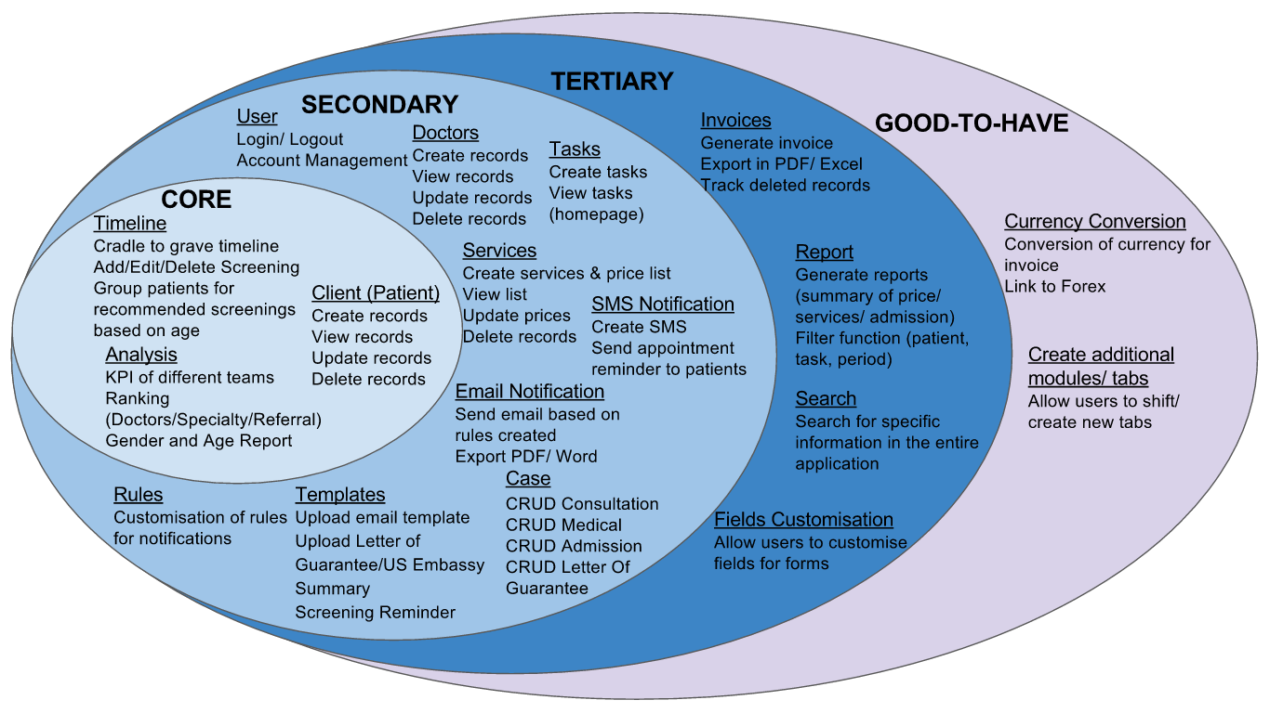

Acceptance Scope
Introduction
Problem and Solution
Technologies
User Testing
Project Management
X-Factor
Reflections
Notes:
10/34

Slide 48
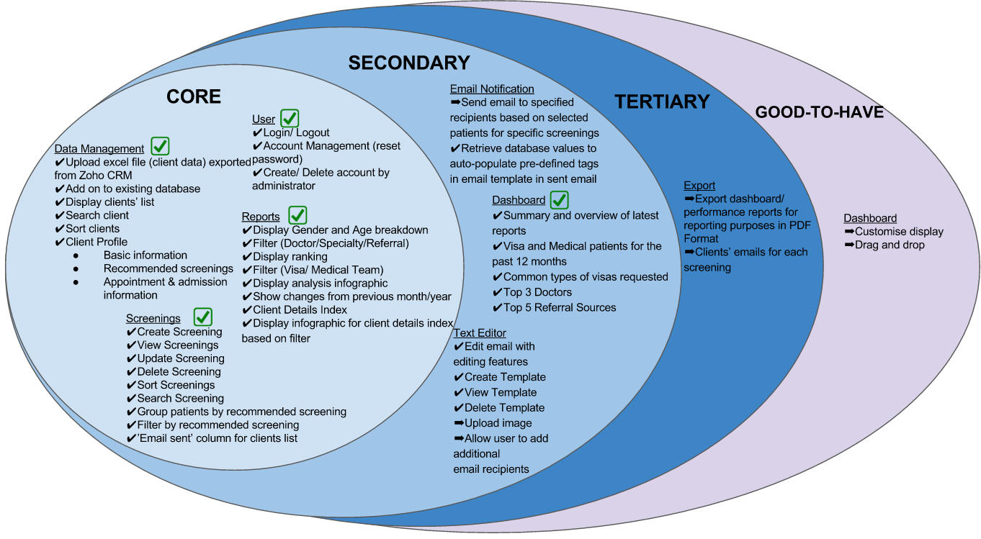

Actual Scope
83%
Completed
Introduction
Problem and Solution
Technologies
User Testing
Project Management
X-Factor
Reflections
Notes:
35/43
Data Management combines uploading excel file with client info(profile)

Slide 49
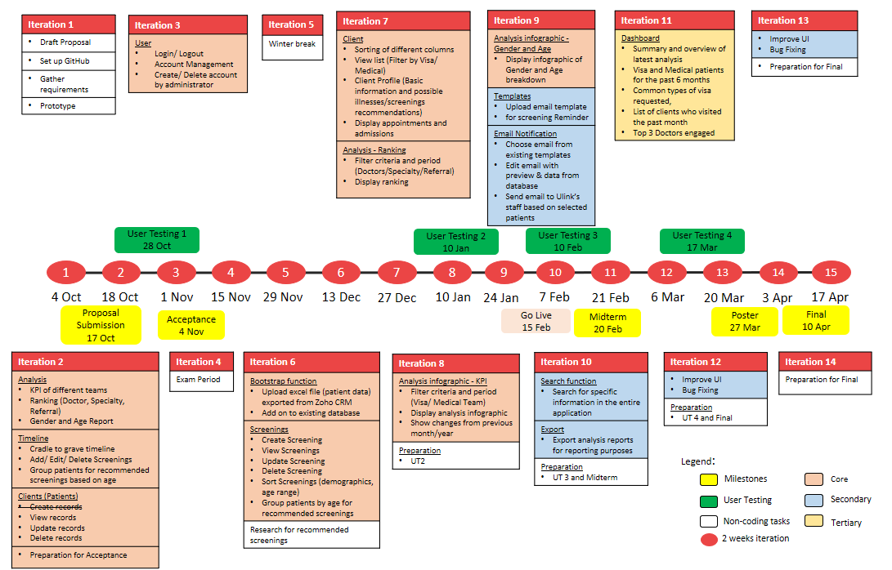
Planned Schedule
Introduction
Problem and Solution
Technologies
User Testing
Project Management
X-Factor
Reflections

Slide 50
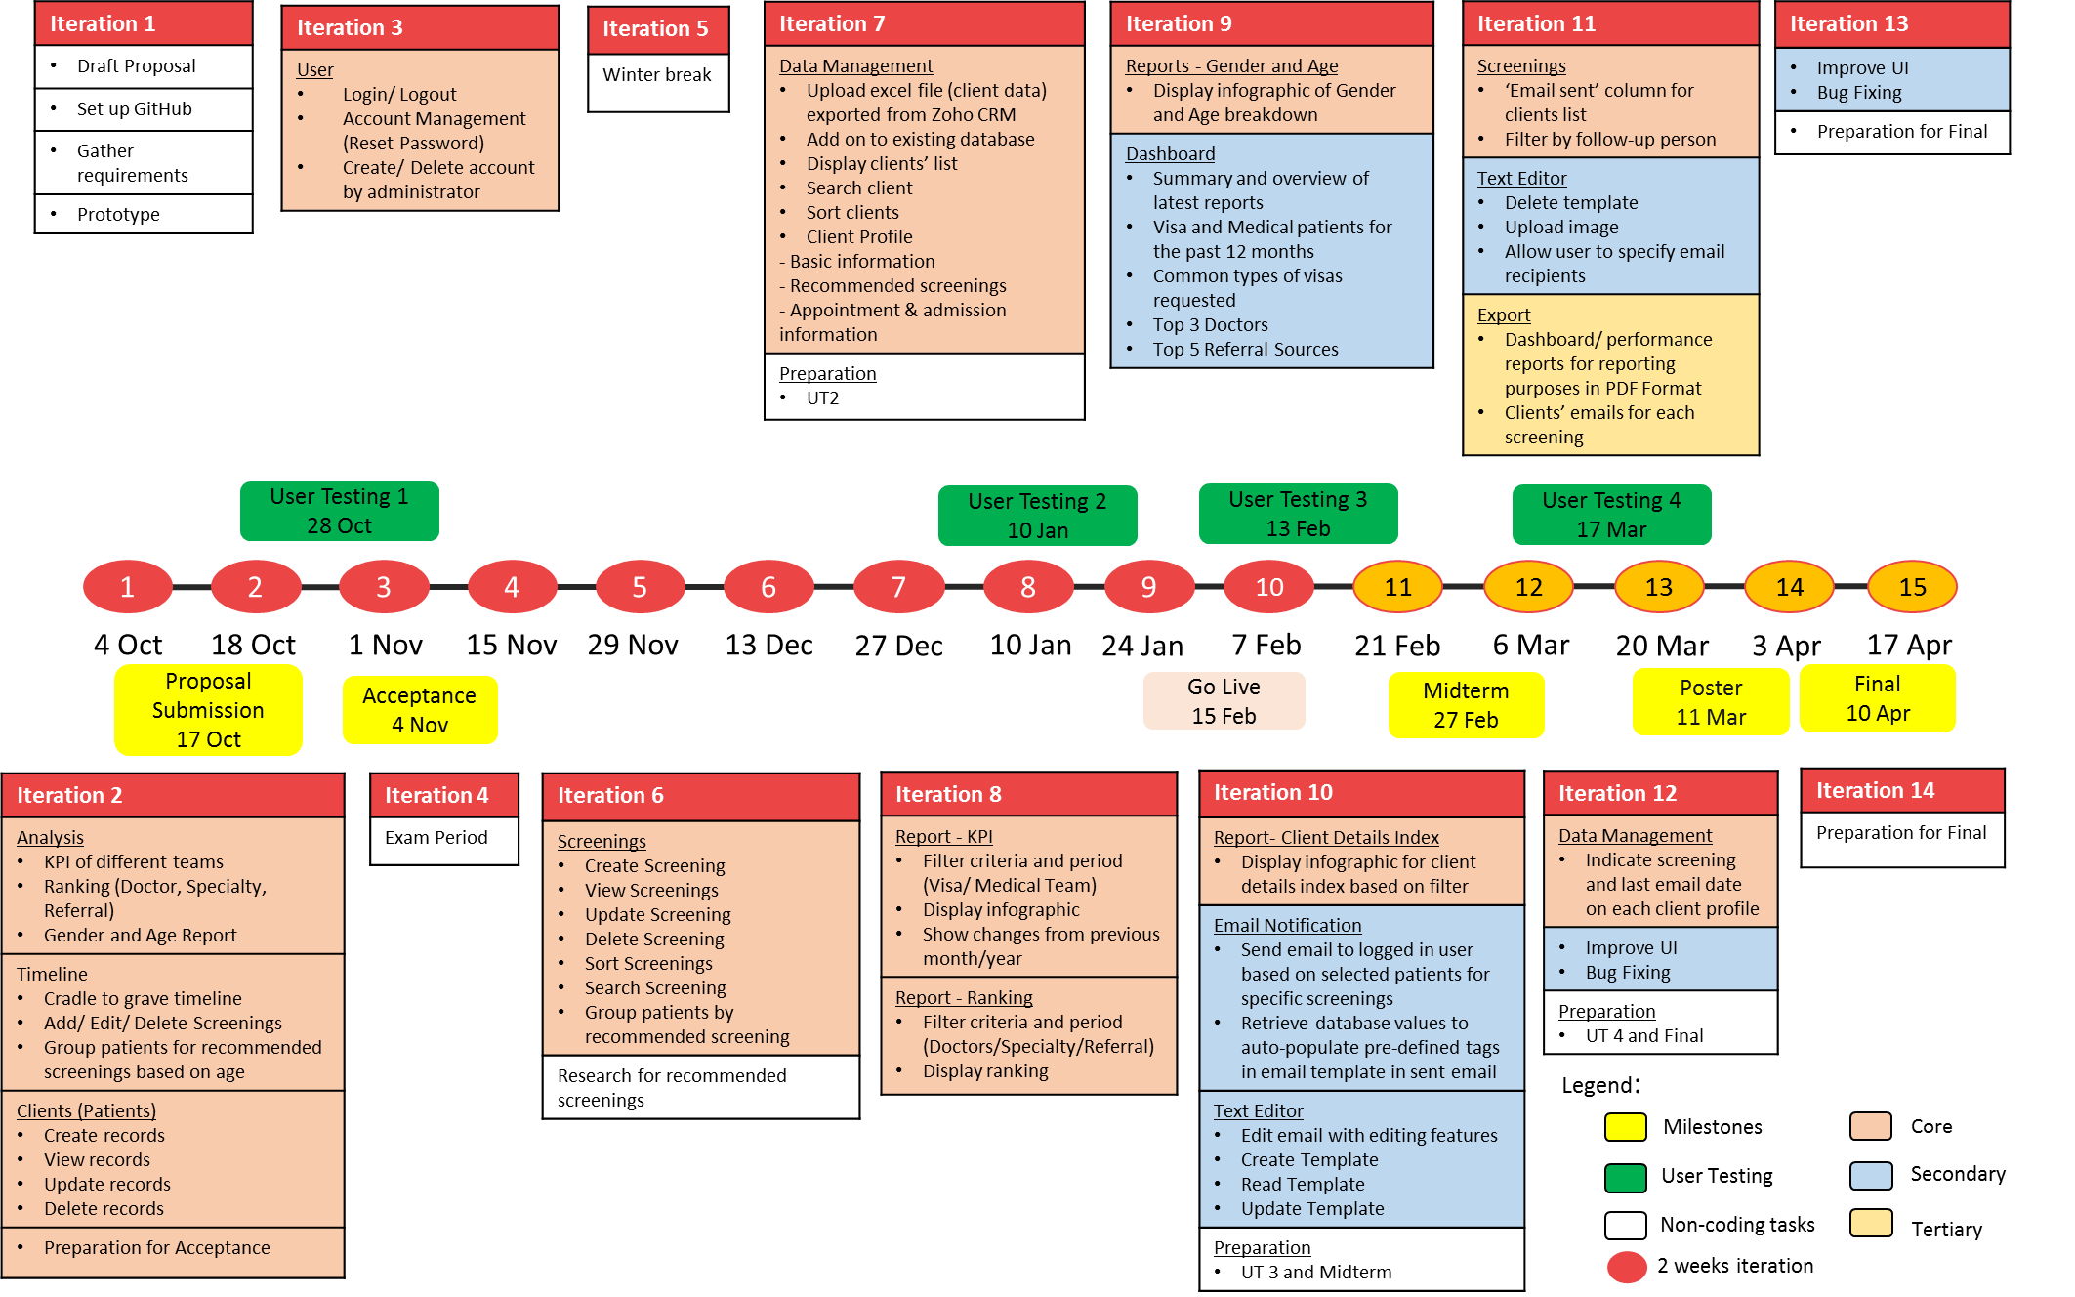
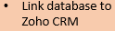
Actual Schedule
Introduction
Problem and Solution
Technologies
User Testing
Project Management
X-Factor
Reflections

Slide 51
Change Management

Slide 52
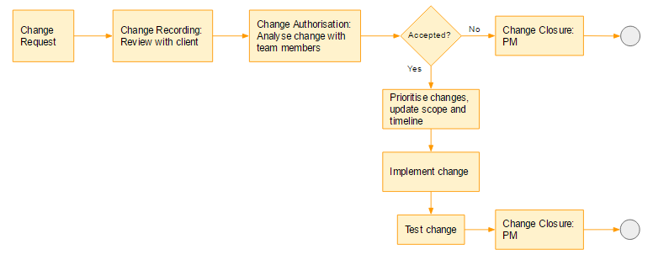
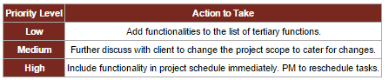
Change Management Process
Introduction
Problem and Solution
Technologies
User Testing
Project Management
X-Factor
Reflections

Slide 53


Changes
Added/Modified | Removed
Report – POC Index | Doctors
Database – take in additional fields from excel file | Tasks
CRUD Templates feature | Services
Screenings – follow up person | SMS Notification
Screenings – email sent column | Rules
Text editor allows selection of recipients | Invoices
Text editor allows upload of images | Currency Conversion
Export client emails in excel | Creating additional tabs/ modules
Introduction
Problem and Solution
Technologies
User Testing
Project Management
X-Factor
Reflections

Slide 54
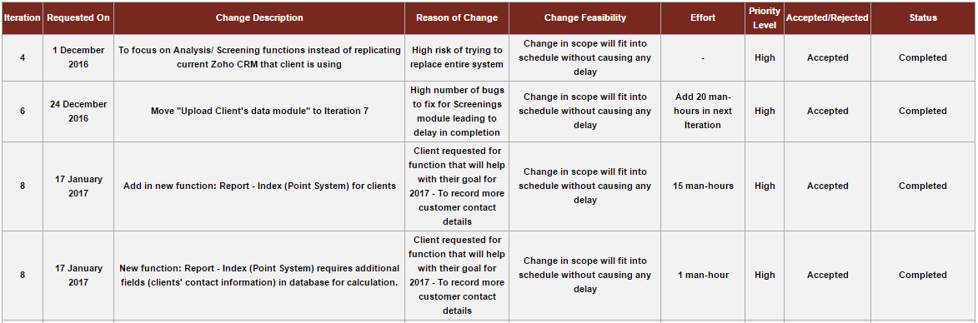
Change Log
Introduction
Problem and Solution
Technologies
User Testing
Project Management
X-Factor
Reflections

Slide 55
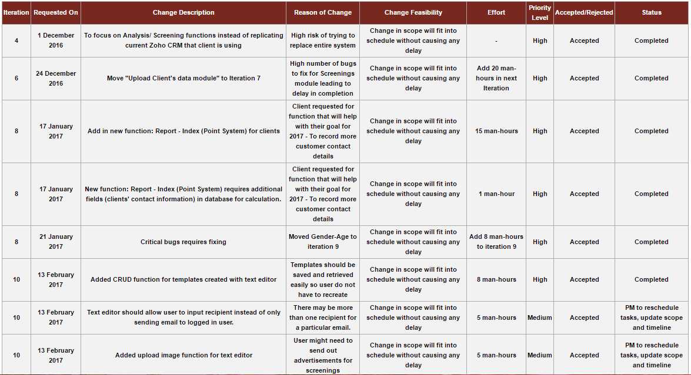
Change Log
Introduction
Problem and Solution
Technologies
User Testing
Project Management
X-Factor
Reflections

Slide 56
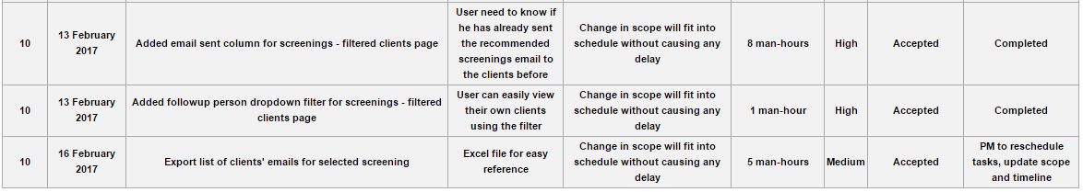
Change Log
Introduction
Problem and Solution
Technologies
User Testing
Project Management
X-Factor
Reflections

Slide 57
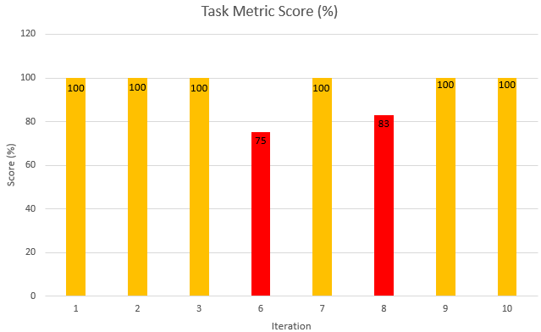
Task Metric
Introduction
Problem and Solution
Technologies
User Testing
Project Management
X-Factor
Reflections

Slide 58
Task Metric
Iteration | Iteration 6 | Iteration 8
Actual : Planned (Tasks) | 6 : 8 | 5 : 6
TM Score | 75% | 83%
Problem | Bugs: Screenings Edit screenings – unable to update screenings Delete button deletes a particular screening for both genders | Bugs: Reports – KPI and Ranking Incorrect data displayed UI – date picker, filter values
Action taken | Shifted uploading data to next Iteration | Shifted Gender - Age report to next Iteration
Introduction
Problem and Solution
Technologies
User Testing
Project Management
X-Factor
Reflections

Slide 59
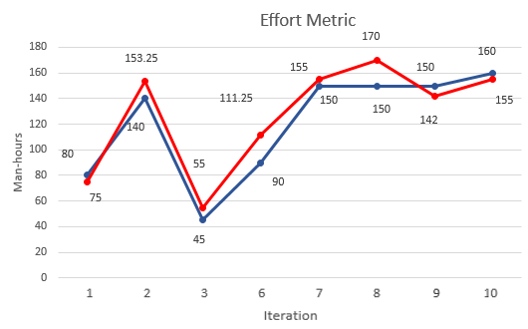
Effort Metric
Introduction
Problem and Solution
Technologies
User Testing
Project Management
X-Factor
Reflections
Notes:
2 – before acceptance, underestimate hours required for preparation
3 – schedule hours for bug fixing
6 – CRUD screenings not as easy as we thought
8 – Data management too much time - Iter 7 Ranking was shifted to iter 8. hence iter 8 has ranking and kpi functions to complete
9 – Over estimated time required for dashboard + gender and age report (more of charts and display)

Slide 60
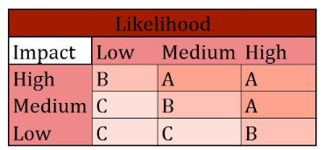

Risk Management
Technical Risk
Unfamiliar with coding language
E,g. Javascript, JQuery
More experienced developer to share knowledge
Developers to research & learn technologies
Assistant developer to help with complex tasks
Introduction
Problem and Solution
Technologies
User Testing
Project Management
X-Factor
Reflections

Slide 61
Risk Management
Project Management Risk
Allocation of too much/ little time for development of functions
Buffer days before submission
Allocate more time for more complex tasks
Introduction
Problem and Solution
Technologies
User Testing
Project Management
X-Factor
Reflections

Slide 62
Risk Management
Client Risk
Change in client’s requirement
Meet & update client bi-weekly
Ensure that development is on par with client’s requirements
Present client prototype before development
Introduction
Problem and Solution
Technologies
User Testing
Project Management
X-Factor
Reflections

Slide 63
X-FACTOR
Midterm
At least 50% of clients’ responses (via email, phone calls)
Introduction
Problem and Solution
Technologies
User Testing
Project Management
X-Factor
Reflections
Notes:
Current % of repeat clients: 14.3036%
Finals, make some improvements to emails sent out (mkting)

Slide 64
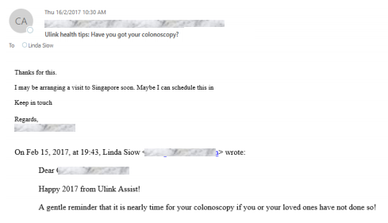
X-FACTOR
Introduction
Problem and Solution
Technologies
User Testing
Project Management
X-Factor
Reflections
Notes:
Current % of repeat clients: 14.3036%
Finals, make some improvements to emails sent out (mkting)

Slide 65
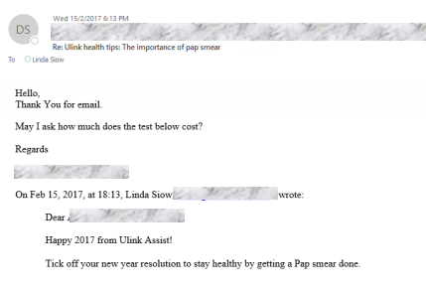
X-FACTOR
Introduction
Problem and Solution
Technologies
User Testing
Project Management
X-Factor
Reflections
Notes:
Current % of repeat clients: 14.3036%
Finals, make some improvements to emails sent out (mkting)

Slide 66
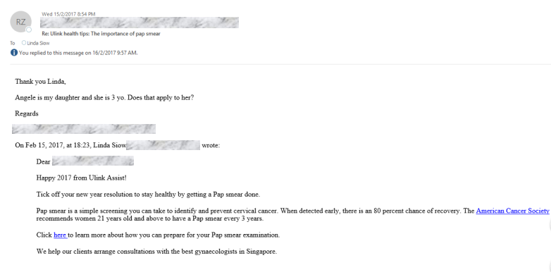
X-FACTOR
Introduction
Problem and Solution
Technologies
User Testing
Project Management
X-Factor
Reflections
Notes:
Current % of repeat clients: 14.3036%
Finals, make some improvements to emails sent out (mkting)

Slide 67
X-FACTOR
Final
Ulink Reporting System fetches live data from Zoho CRM
Increase user interactions with the system by 15 %
Introduction
Problem and Solution
Technologies
User Testing
Project Management
X-Factor
Reflections
Notes:
Current: Once a month 1 out of 20 days > 5%
Target: Weekly 4 out of 20 days > 20%
Current % of repeat clients: 14.3036%
Finals, make some improvements to emails sent out (mkting)

Slide 68
What’s next?
Text Editor – upload image & allow user to specify email recipients
Export reports function
Bug fixes for UT 4
UI Improvements
Iteration 12
(6 March 2017)
Iteration 14
(3 April 2017)
After midterms
Iteration 13
(20 March 2017)
Link database with Zoho CRM
Bug fixes
UI Improvements
UT 4
Bug fixes
Preparation for Final presentation

Slide 69





Reflections
Shu yan
nicole
I have learnt the importance of conducting User Testing and different users have different expectations of the system
I am more familiar with front-end development and feedback from users are very important to me as they help to make the UI more user-friendly
Sean
Learnt to prioritise changes and adopt suggestions from user so that we can improve the system
Kaixin
Nabilah BANU
Knowing how to prepare for change and understanding business requirements is important to deliver a good product
In addition to gathering user requirements, I’ve learnt more about front-end development as an assistant front-end developer
Introduction
Problem and Solution
Technologies
User Testing
Project Management
X-Factor
Reflections

Slide 70

Thank you

Slide 71
User Testing 3 Procedure
Login
Data Management (Client)
Reports -KPI
Reports - Ranking
Gender and Age
Screening
Dashboard
Email Recommended Screenings
Introduction
Problem and Solution
Technologies
Project Management
User Testing
X-Factor
Reflections

